Slide 1

TITLE
Group 760

Slide 2

CONTENT
INTRODUCTION
CONVERTER DESIGN
MPPT ALGORITHM
TESTS RESULTS
DISCUSSION
CONCLUSION

Slide 3

Introduction

Slide 4
Motivation
Global need of transition towards clean energy.
Wind and solar energy production as fastest growing method in 2017.
I don’t know what else to say here.
Include picture.

Slide 5
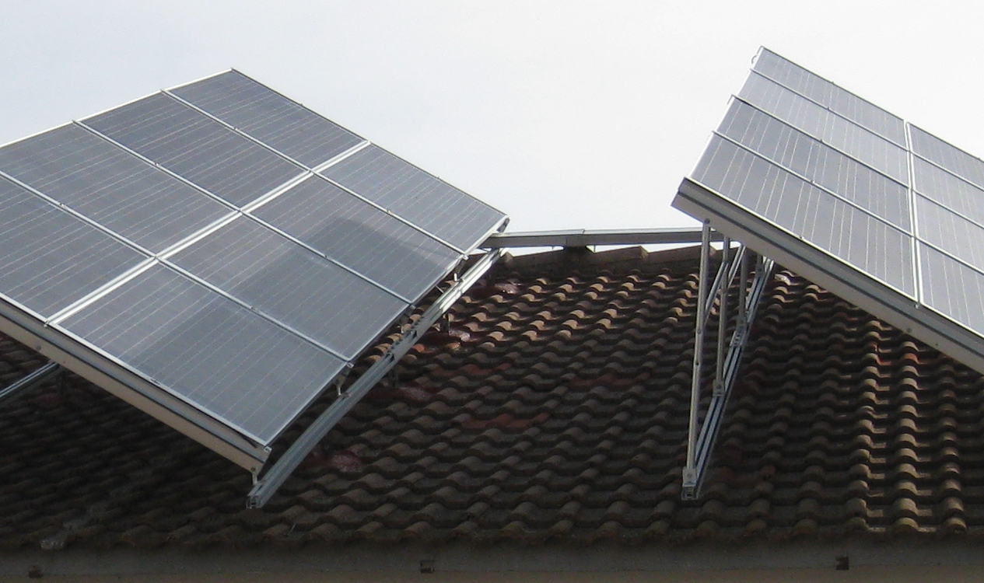
Existing problem
Mismatches:
Production tolerances
Partial shading
Cracks
Uneven aging
The Groene Energie: https://www.dgem.nl/nl/zonne-energie/opbrengstvariabelen-zonnepanelen

Slide 6
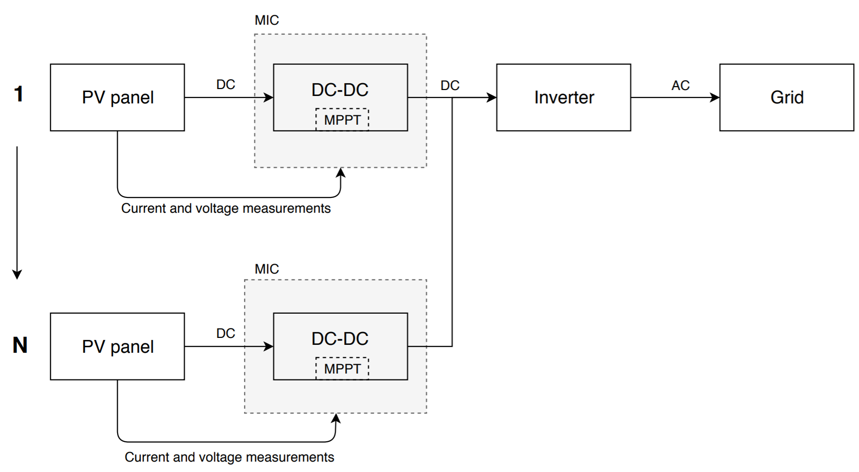
What is a module integrated converter (MIC)?
Module integrated converter.
Is a part of each PV module.
Prevents mismatch losses.

Slide 7
MIC characteristics - Consider pros and cons
Allows individual maximum power point tracking.
Replaces bypass diode.
Higher system efficiencies achieved under mismatches.
Certain topologies allow bidirectionality.
Could imply lower efficiency under specific cases.
Are we saying anything else? Cost?

Slide 8

PCB layout

Slide 9
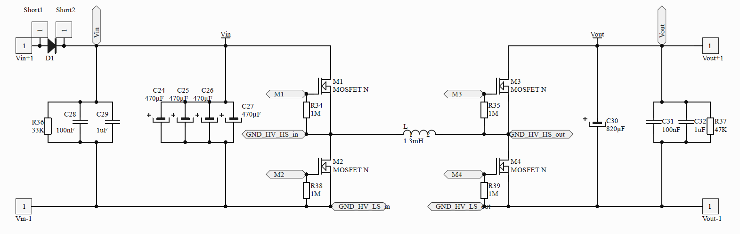
Power circuitry
Discharging resistors.
Protection diodes.
High frequency capacitors.

Slide 10
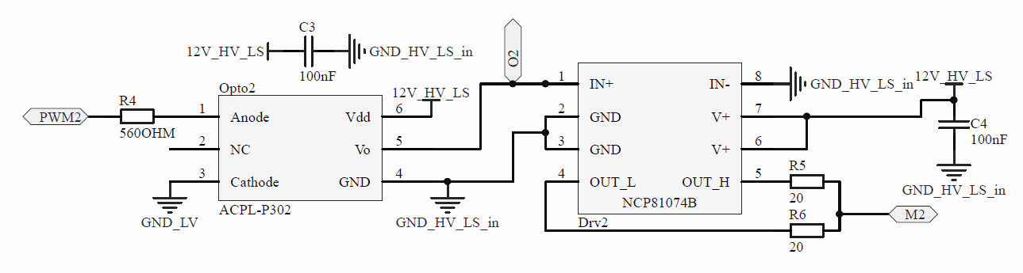
Driving circuitry
Optocouplers for isolation.
Decoupling capacitors.
Current limiting resistors.

Slide 11
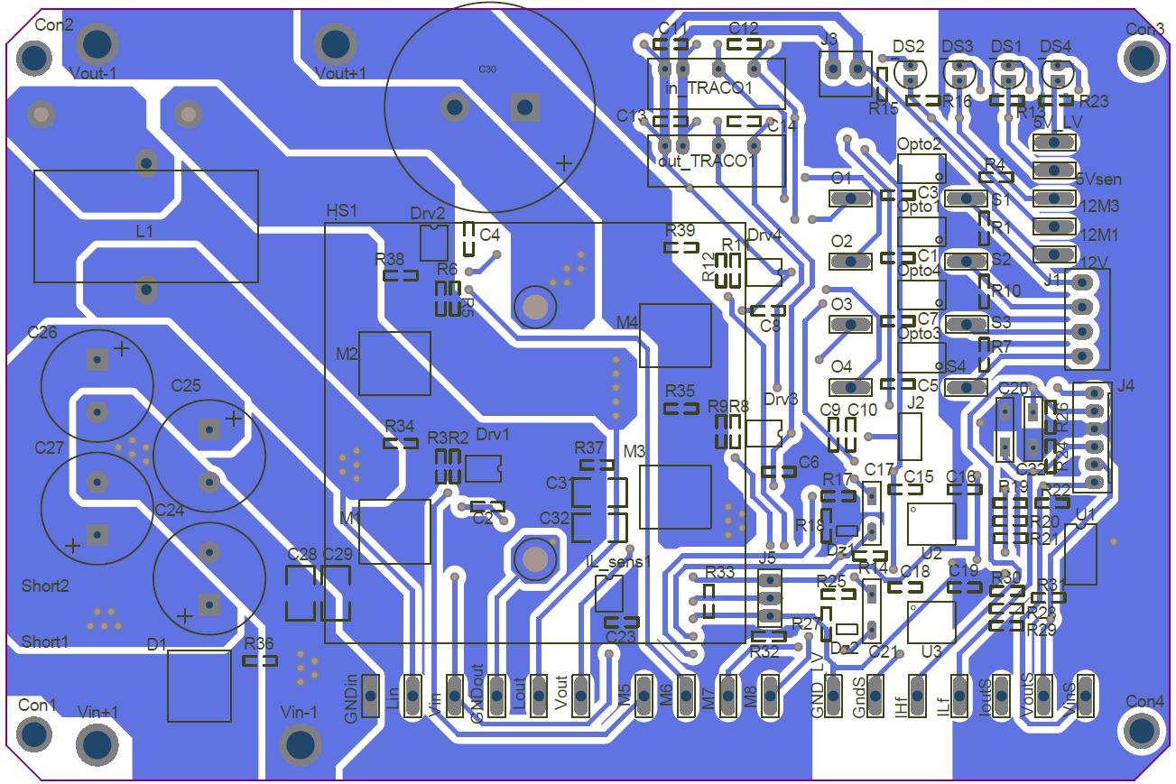
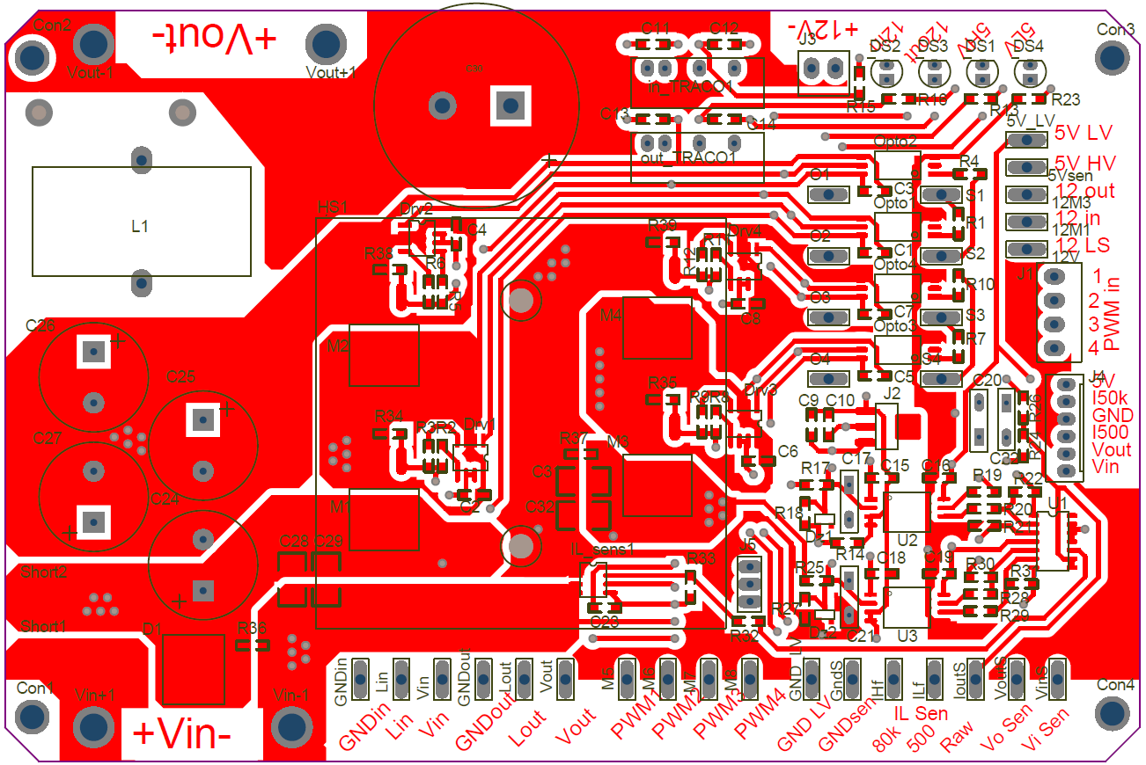
PCB layout
Considerations:
Hot and cold spots.
Isolations.
Interferences.
Others.

Slide 12
Hot and cold spots
Clear separation of hot and cold sides.
High power.
Low power,
Main side.
Low power,
Isolated side.

Slide 13
Interferences
Minimal current loops.
Hall sensor location.
Ground planes.
Removed ground plane under inductor.

Slide 14
Isolations
Isolation bridge under high and low voltage..

Slide 15
Others
Test points.
Other measuring points and user communication.
Heat sink location.
10mm power traces.

